Slide 1
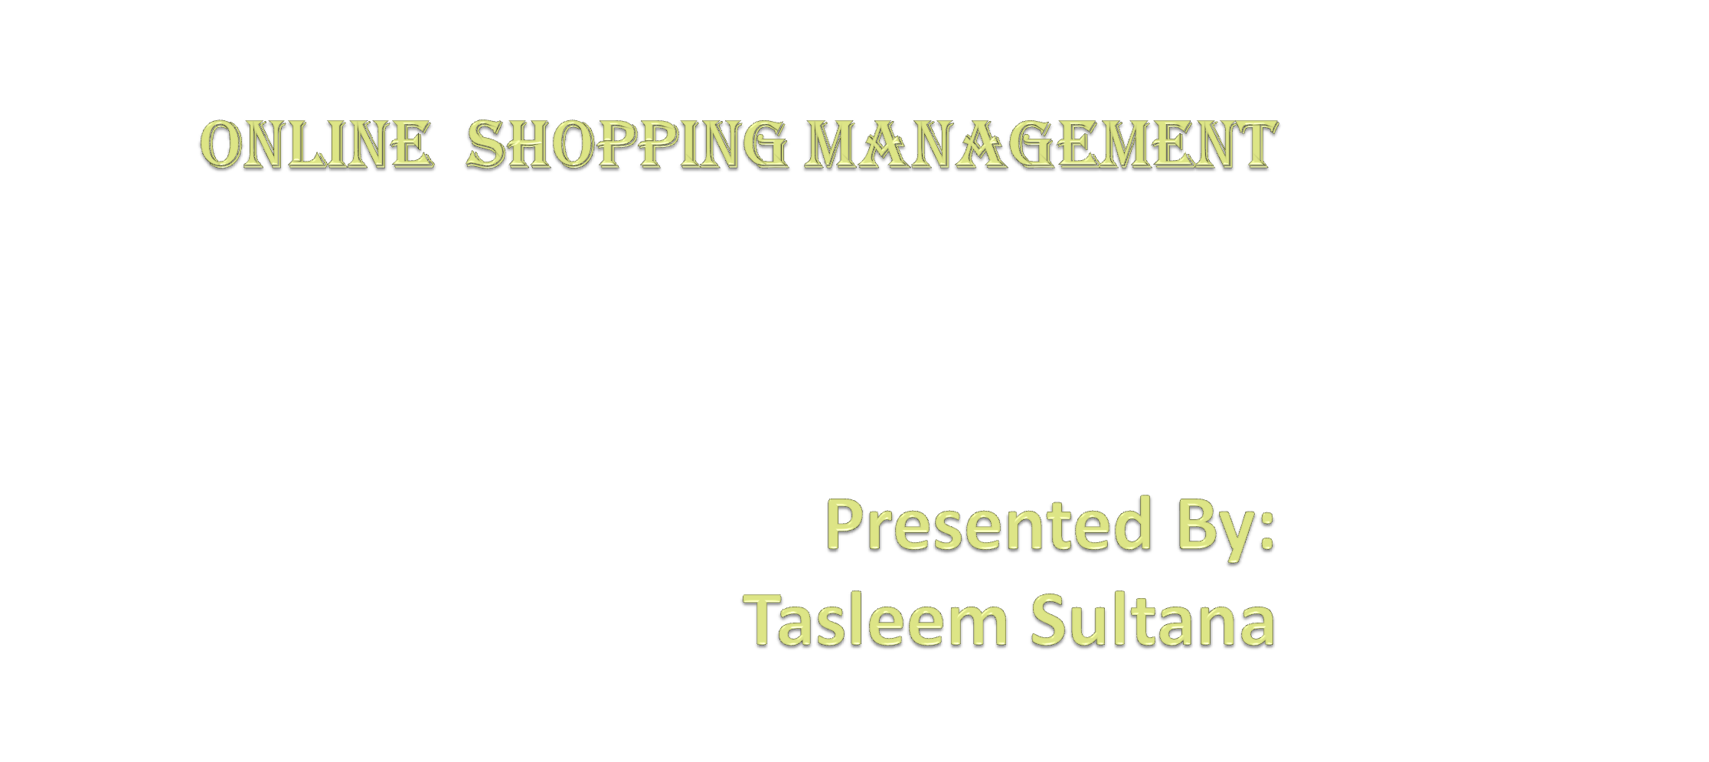


Slide 2
CONTENTS
INTRODUCTION
OBJECTIVE
PURPOSE
EXISTING SYSTEM
PROPOSED SYSTEM
TECHNOLOGIES
FUTURE SCOPE
CONCLUSION

Slide 3
INTRODUCTION
Online shopping is a form of electronic commerce which allows consumers to directly buy goods or services from a seller over the internet using a web browser.
Customers can shop online using a range of different computers and devices, including desktop computers and smart phones.
Online customers must have access to the internet and a valid method of payment in order to complete a transaction.
Online stores are usually available 24 hours a day, and many consumers in Western countries have internet to access both at work and at home.

Slide 4
OBJECTIVE
The main objective of the online shopping will help the user to search and buy products online, and using this website user can save his/her time by not going to different shops to search products.
Efficiency in buying product.
Availability
Comparison of products.

Slide 5
PURPOSE
The purpose of this project is to build an application program to reduce the manual work for managing the shopping, internet, products, payment. It tracks all the details about the payment, bills, customer.
It Provides a very comfortable service for customers.
The key concept of the web application is to allow the customer to shop virtually using the Internet and allow customers to buy the products from the store.
The information about the products are stores on an RDBMS at the server side (store). The Server process the customers and the items are shipped to the address submitted by them.
The web application was designed into two modules first is for the customers who wish to buy the products.
Second is for the Owner(admin) who maintains and updates the information about the products.

Slide 6
EXISTING SYSTEM
The current system for shopping is to visit the shop manually and from the available product choose the item customer want and buying the item by payment of the price of the item.
It is less user-friendly.
User must go to shop and select products.
It is difficult to identify the required product.
Description of the product limited.
It is a time consuming process.
Not in reach of distant users.

Slide 7
PROPOSED SYSTEM
In the proposed system customer need not go to the shop for buying the products.
He can order the product he wish to buy through the application in his Smartphone.
The shop owner will be admin of the system. Shop owner will managing the customers and product orders.
The system also recommends a home delivery system for the purchased products.

Slide 8
TECHNOLOGIES
FRONT END:
HTML (Hyper Text Markup Language) : HTML is a syntax used to format a text document on the web.
Java Script JS : It is a dynamic computer programming language.
It is most commonly used as part of web browsers, whose implementations allow client-side scripts to interact with the user, control the browser, communicate asynchronously, and alter the document content that is displayed.
Java Script is used to create pop up windows displaying different alerts in the system like “User registered successfully”, ”Product added to cart” etc.
CSS(Cascading Style Sheet):-Used for applying various styles to the web pages
DATABASE:MYSQL

Slide 9
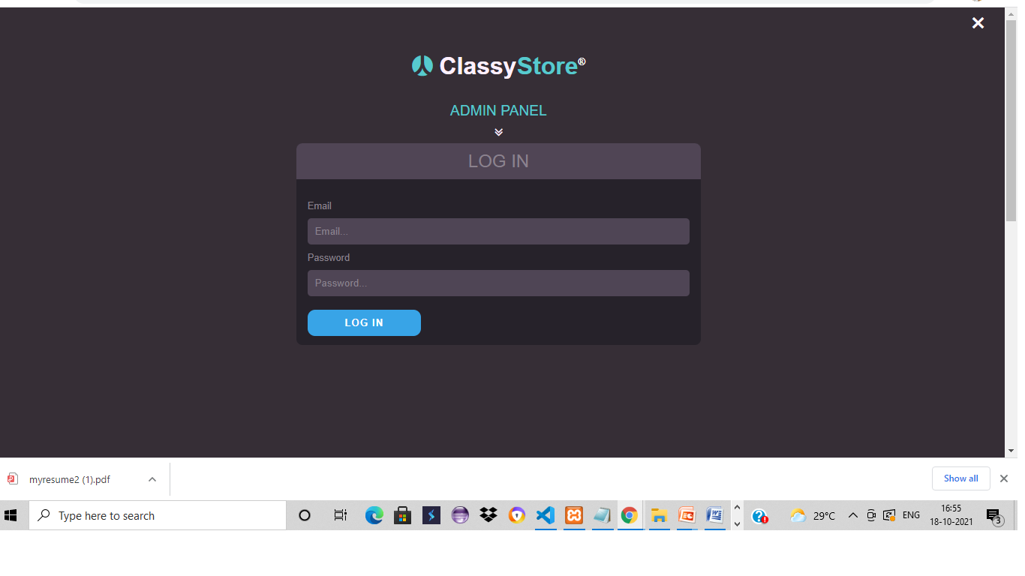
SCREENSHOTS
Admin Login :-

Slide 10
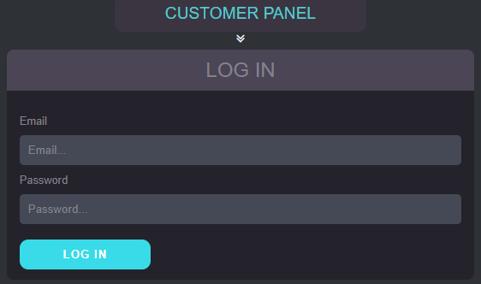
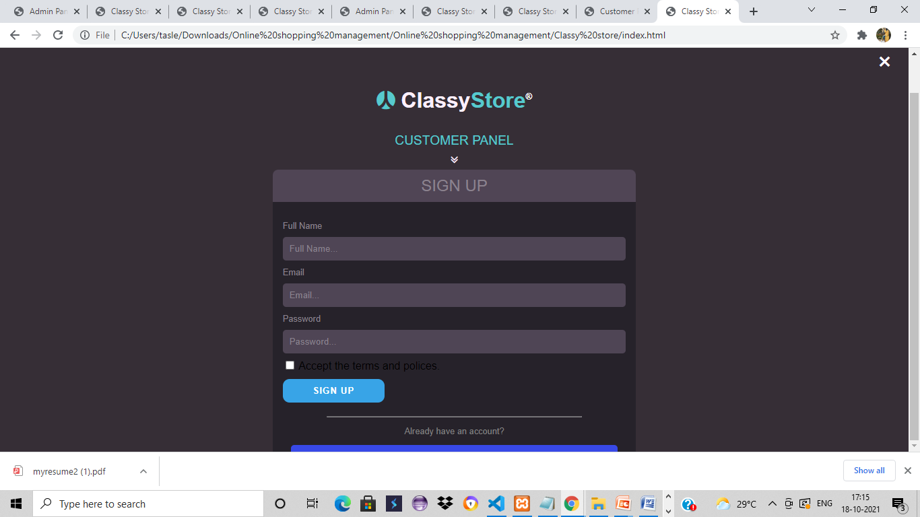
customer login:-
Customer signup:-

Slide 11
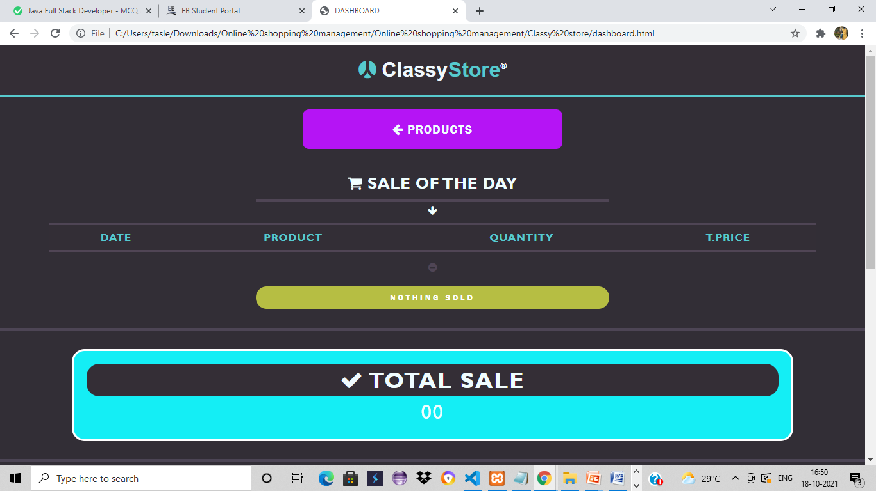
Dashboard:-

Slide 12
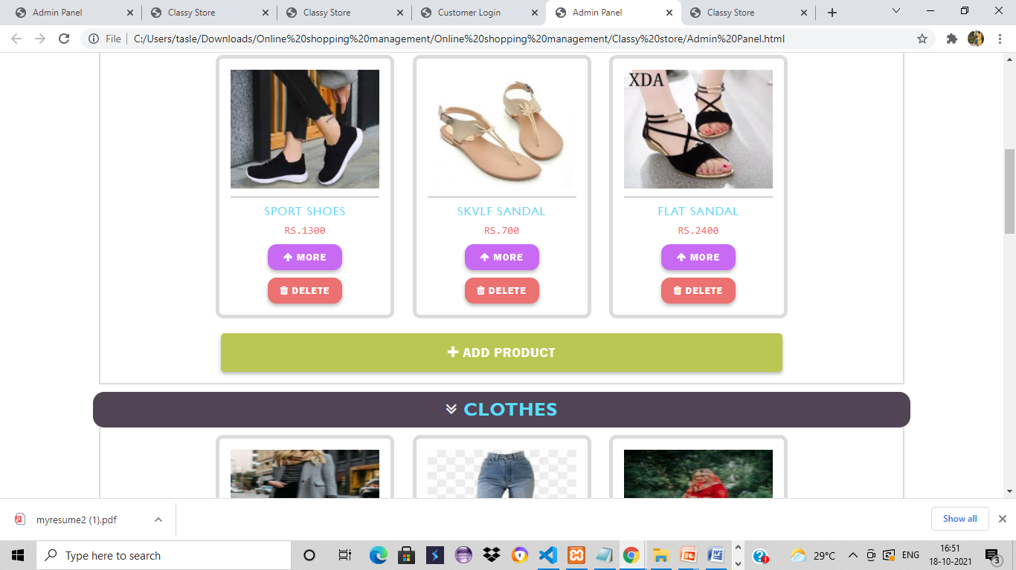
PRODUCTS:-

Slide 13
FUTURE SCOPE
This designed online shopping system provides a 24/7 service, that customer can place orders anytime anywhere they wish to.
Features can be added to this system in future involve implementation by local shopkeepers, where shops will be providing online interface to customers for shopping and placing orders.
This will be adding on benefit for the customers as it will save their time, plus it adds on for the shopkeepers also, as people will continue to shop from local shops rather than preferring to supermarkets every time.
A chat box for public benefit is also a great idea via which people can directly have a conversation with some officials regarding any type of queries.

Slide 14
CONCLUSION
Online shopping allow customers to place order without even visiting the shop.
Being able to buy any time, any place, anywhere.
This site enables them to browse before they shop, and to research the product so they have more confidence in what they are buying.
Online shopping become more enjoyable and easier than real-world shopping.
On my site you will get all items genuine and trusty, just check once here before buy anywhere.

Slide 15

.

